Slide 1
Proteomics Informatics –
Protein Characterization II:
Protein Interactions (Week 11)

Slide 2
Discovering New Protein Interactions with
Affinity Capture Mass Spectrometry
E
A
F
D
A
C
B
Digestion
Mass spectrometry
Identification

Slide 3
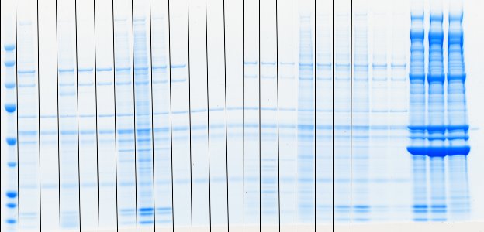
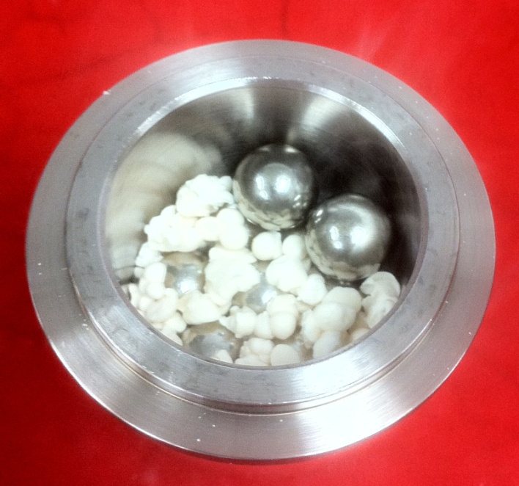
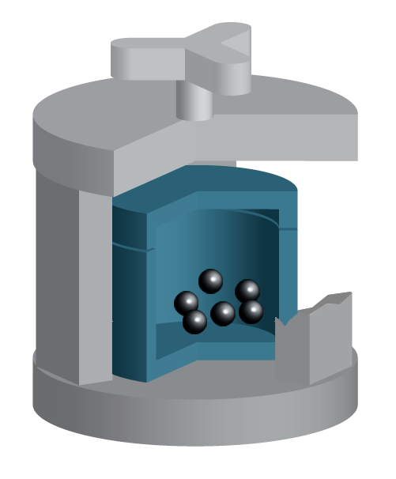
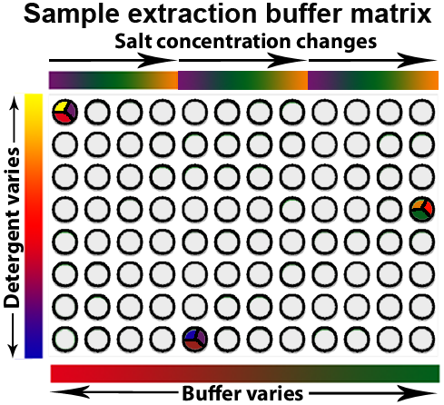
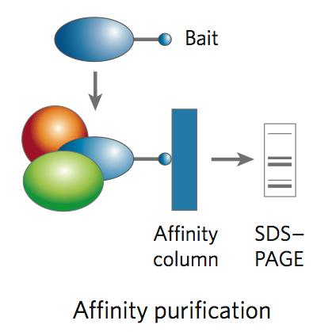
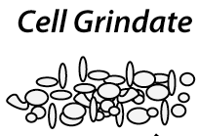
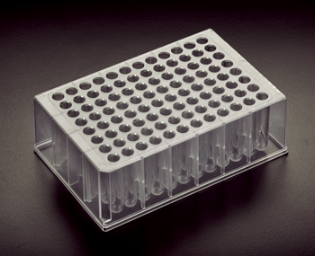
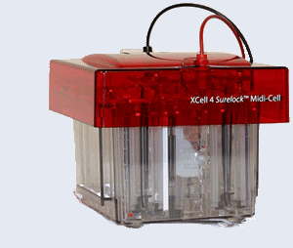
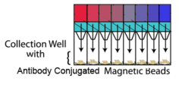
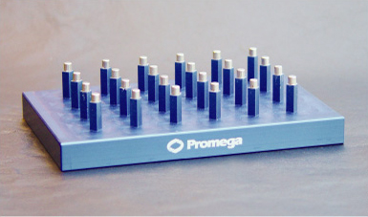
Affinity Capture Optimization Screen
Cell extraction
More / better quality interactions
+
Filtration
Lysate clearance/
Batch Binding
SDS-PAGE
Binding/Washing/Eluting
Notes:
Grindate is critical!
~100mg of yeast is ~40mL of an avg mid-late log culture – in a single 1.2ml deep well
development of a non-fouling filter was critical - Orochem

Slide 4
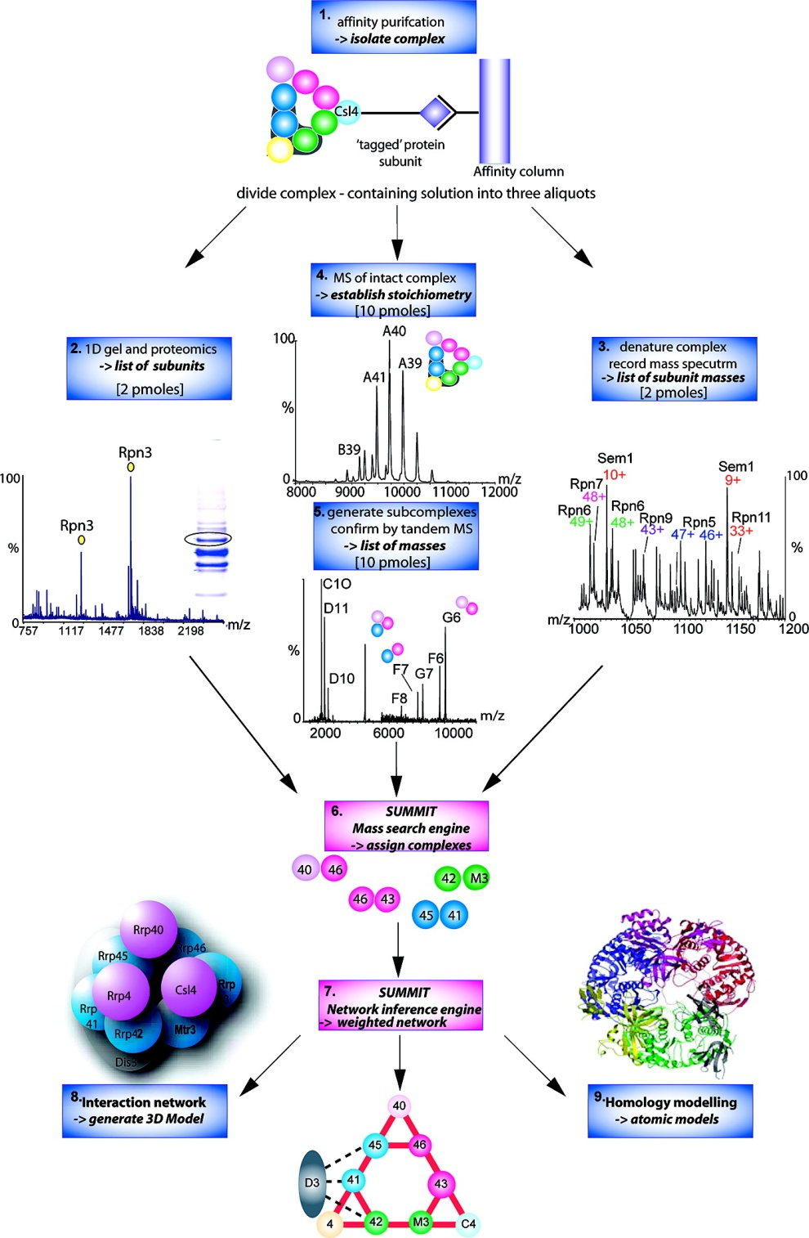
Analysis of Non-Covalent Protein Complexes
Taverner et al., Acc Chem Res 2008

Slide 5
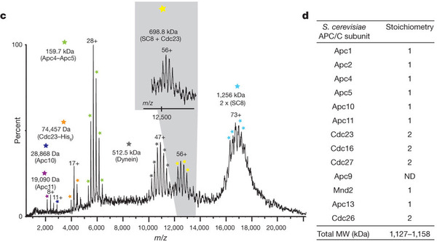
Non-Covalent Protein Complexes
Schreiber et al., Nature 2011

Slide 6
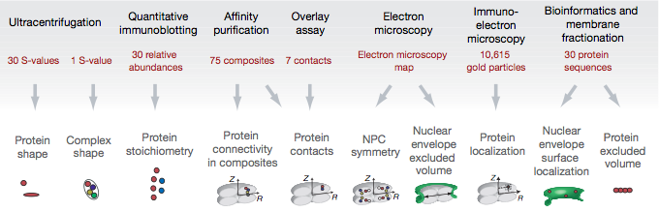
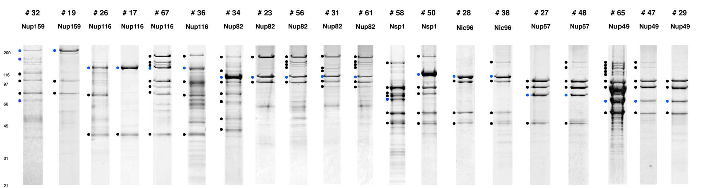
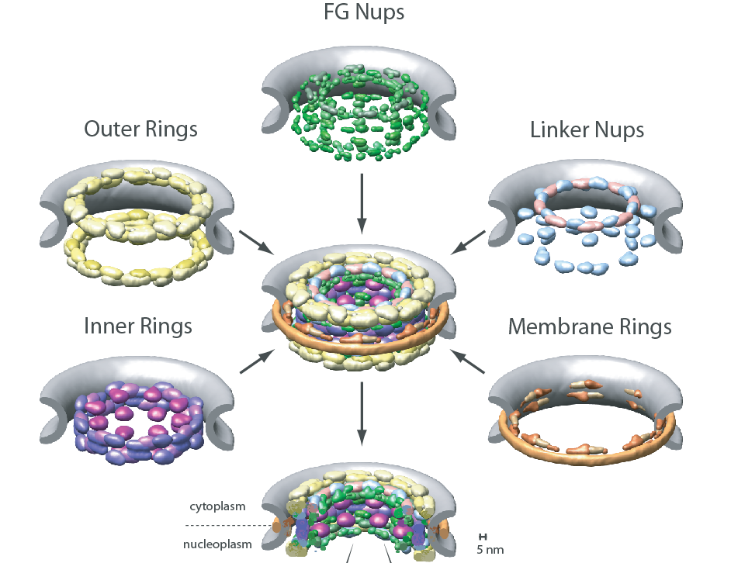
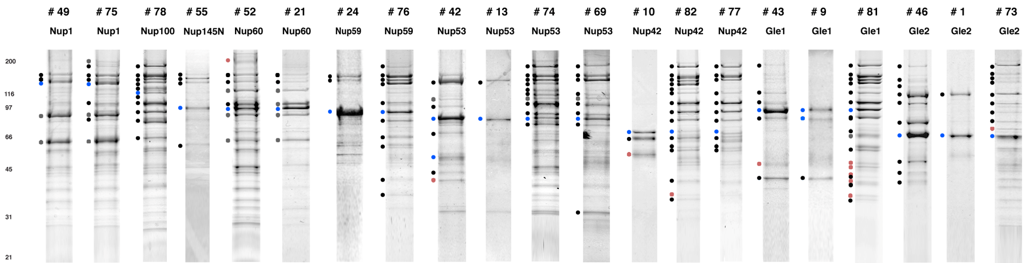
Molecular Architecture of the NPC
Over 20 different extraction and washing
conditions ~ 10 years or art.
(41 pullouts are shown)
Actual model
Alber F. et al. Nature (450) 683-694. 2007
Alber F. et al. Nature (450) 695-700. 2007
Notes:
Molecular architecture of the nuclear pore – “Blob Map” (Also applied to the eukaryotic 80S ribosome & 26S proteasome)
456 subunits / 50 MDa / 30 different protein
(But only ~8 folds)
some purifications good, some poor – not every protein responded with equal enthusiasm to our desire to capture its physiological interaction partners - but the value of the data for determining the NPC molecular architecture was high

Slide 7
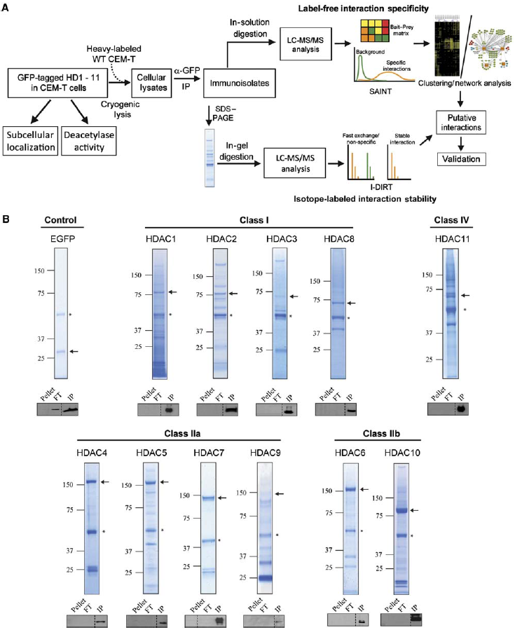
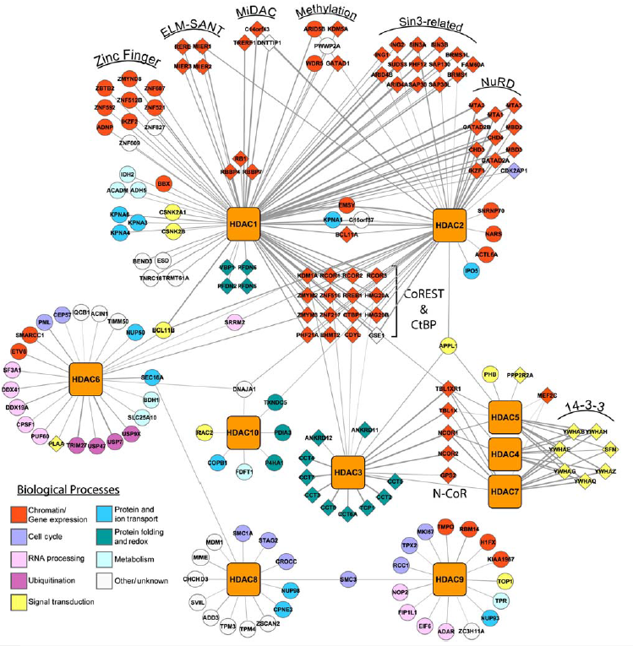
Interaction Map of Histone Deacetylaces
Joshi et al. Molecular Systems Biology 9:672
Notes:
Molecular architecture of the nuclear pore – “Blob Map” (Also applied to the eukaryotic 80S ribosome & 26S proteasome)
456 subunits / 50 MDa / 30 different protein
(But only ~8 folds)
some purifications good, some poor – not every protein responded with equal enthusiasm to our desire to capture its physiological interaction partners - but the value of the data for determining the NPC molecular architecture was high

Slide 8
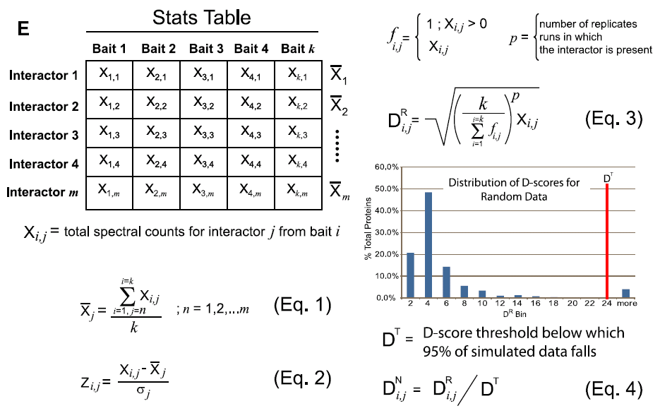
Protein Complexes – specific/non-specific binding
Sowa et al., Cell 2009

Slide 9
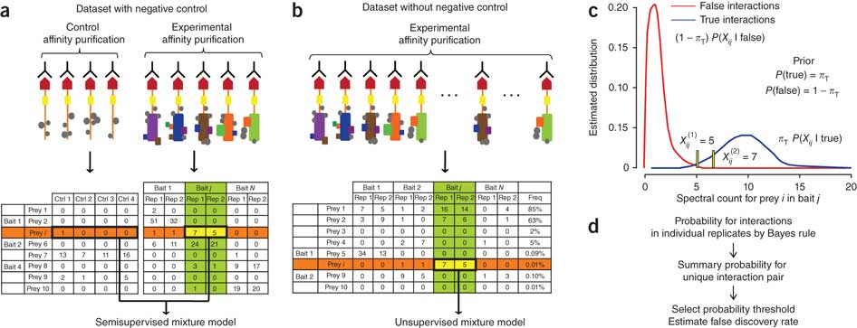
Protein Complexes – specific/non-specific binding
Choi et al., Nature Methods 2010

Slide 10
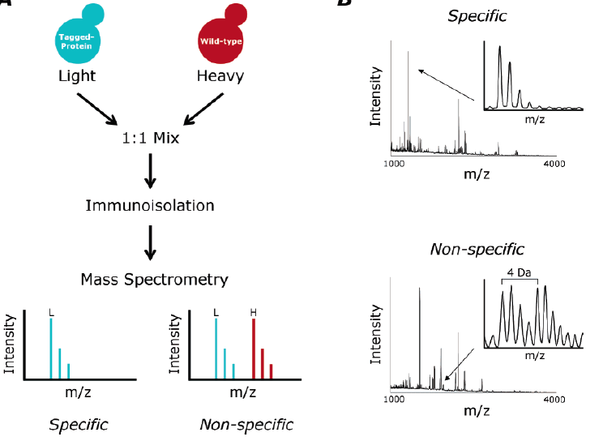
Protein Complexes – specific/non-specific binding
Tackett et al. JPR 2005

Slide 11
Protein
Complex
Interaction Partners by Chemical Cross-Linking
Chemical Cross-Linking
Cross-Linked
Protein Complex
Enzymatic Digestion
MS
Proteolytic
Peptides
Isolation
Fragmentation
MS/MS
Peptides
Fragments
M/Z

Slide 12
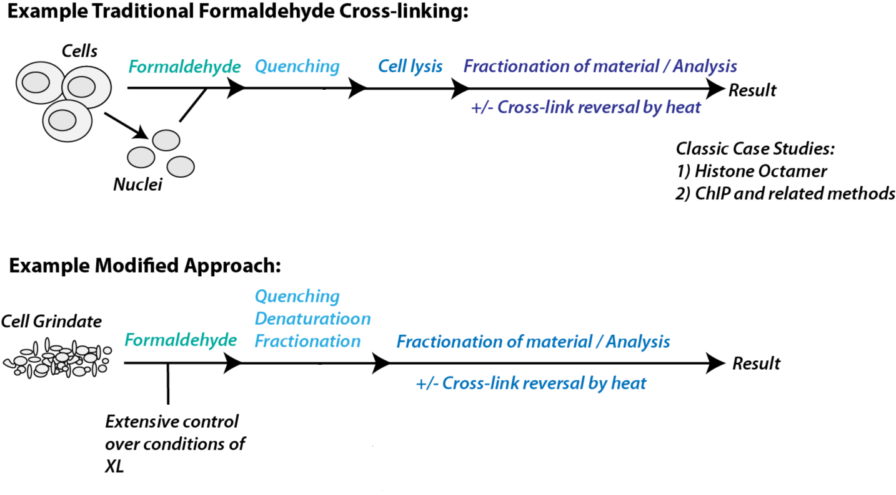
Protein Crosslinking by Formaldehyde
~1% w/v Fal
20 – 60 min
~0.3% w/v Fal
5 – 20 min
1/100 the volume
LaCava

Slide 13
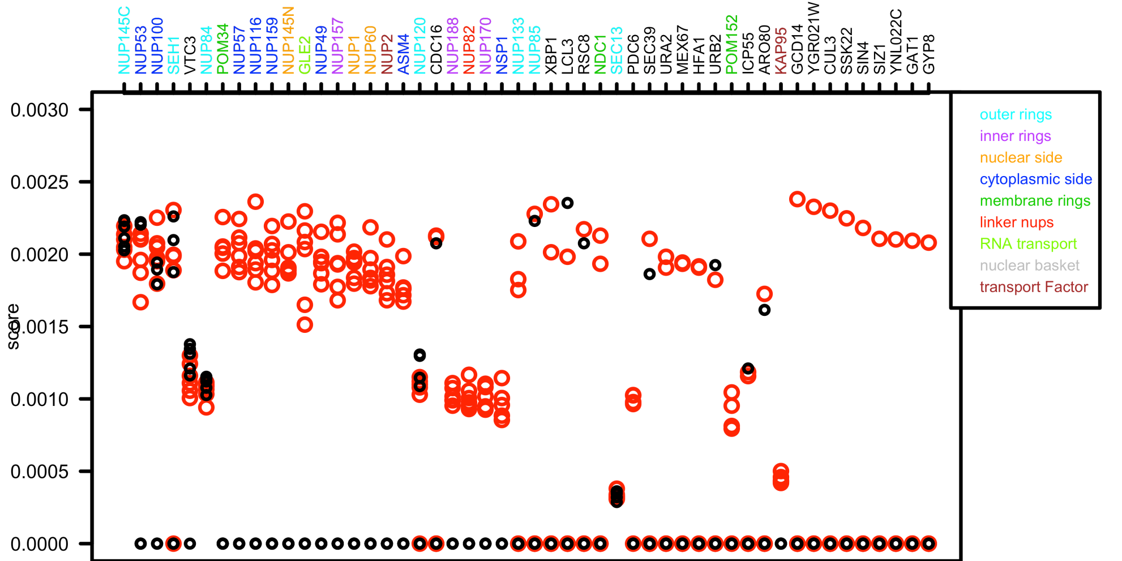
Protein Crosslinking by Formaldehyde
RED: Formaldehyde crosslinking
BLACK: No crosslinking
SCORE: Log Ion Current / Log protein abundance
Notes:
Both are native. OR201206029_RS_XL1. is grindate ,VE20121001_84IV_Std1. is in vivo.

Slide 14
Protein
Complex
Interaction Sites by Chemical Cross-Linking
Chemical Cross-Linking
Cross-Linked
Protein Complex
Enzymatic Digestion
MS
Proteolytic
Peptides
Isolation
Fragmentation
MS/MS
Peptides
Fragments
M/Z

Slide 15
Cross-linking
protein
n peptides with reactive groups
(n-1)n/2 potential ways to cross-link peptides pairwise
+ many additional uninformative forms
Protein A + IgG heavy chain 990 possible peptide pairs
Yeast NPC ˜10⁶ possible peptide pairs

Slide 16
Cross-linking
Mass spectrometers have a limited dynamic range and it therefore important to limit the number of possible reactions not to dilute the cross-linked peptides.
For identification of a cross-linked peptide pair, both peptides have to be sufficiently long and required to give informative fragmentation.
High mass accuracy MS/MS is recommended because the spectrum will be a mixture of fragment ions from two peptides.
Because the cross-linked peptides are often large, CAD is not ideal, but instead ETD is recommended.

Slide 17
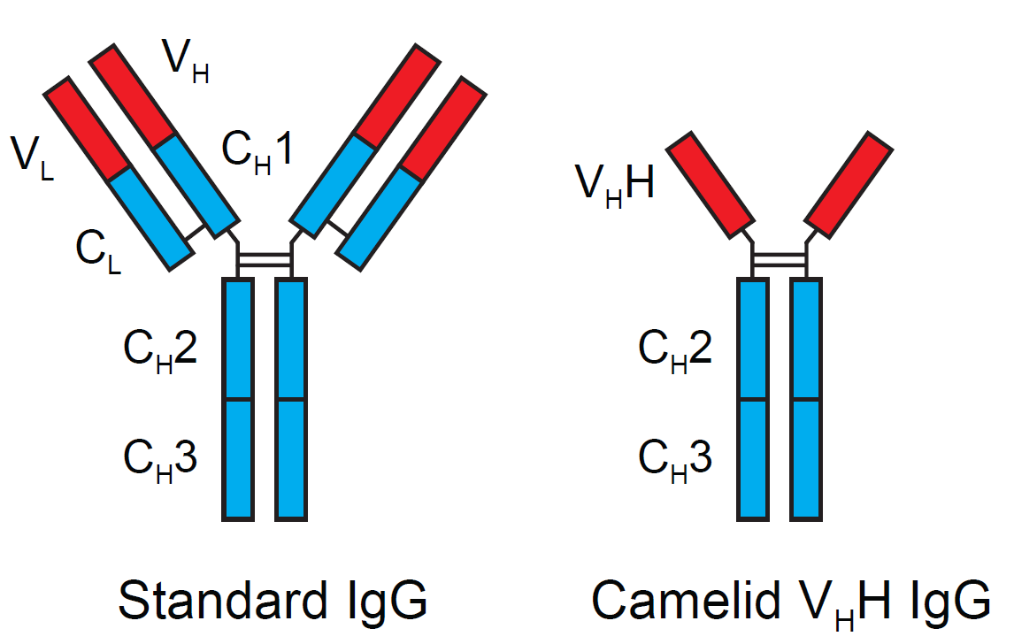
Cloning nanobodies for GFP pullouts
Atypical heavy chain-only IgG antibody produced in camelid family – retain high affinity for antigen without light chain
Aimed to clone individual single-domain VHH antibodies against GFP – only ~15 kDa, can be recombinantly expressed, used as bait for pullouts, etc.
To identify full repertoire, will identify GFP binders through combination of high-throughput DNA sequencing and mass spectrometry
VHH clone for recombinant expression
Notes:
Long-term goal has been development of improved reagents for tagging, isolating proteins/complexes of interest.
Antibodies to existing, ubiquitous tags, like GFP, most useful, effective tools
Looking to develop a recombinant alternative to replace antibodies otherwise required.
Can easily make large quantities of a defined sequence – avoids production problems, mass spec interference

Slide 18
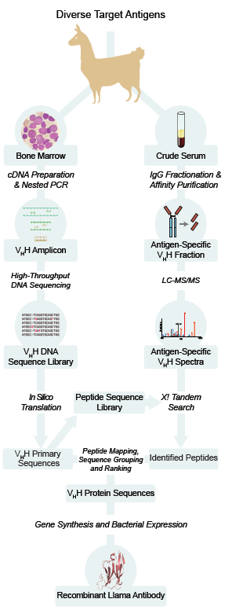
Cloning llamabodies for GFP pullouts

Slide 19
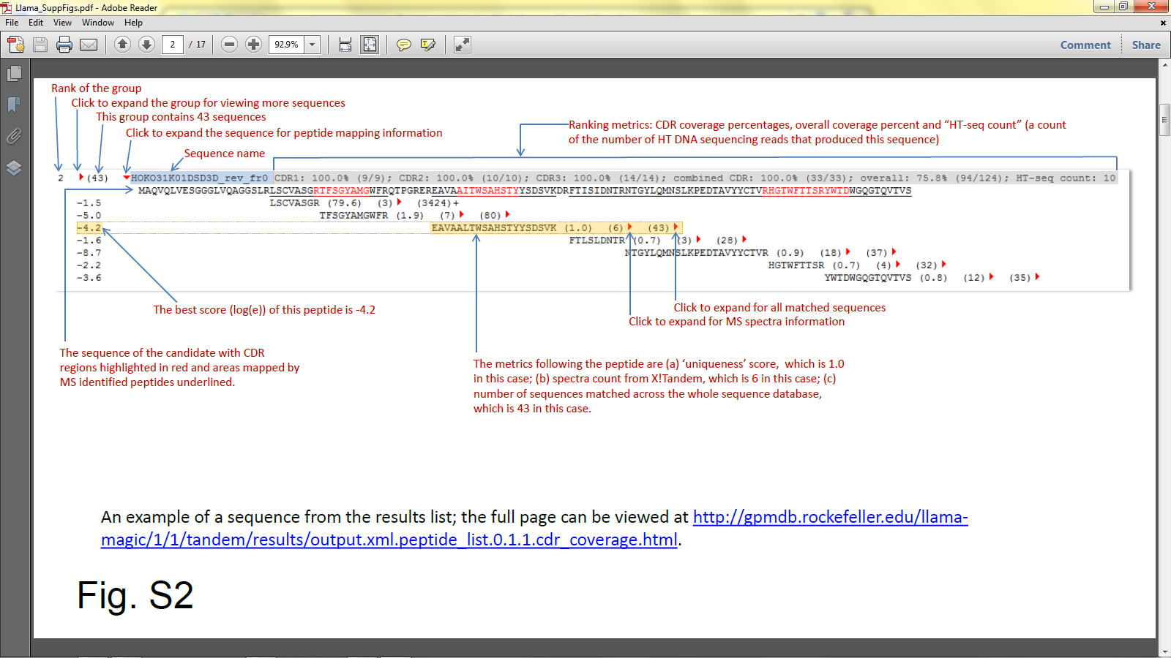
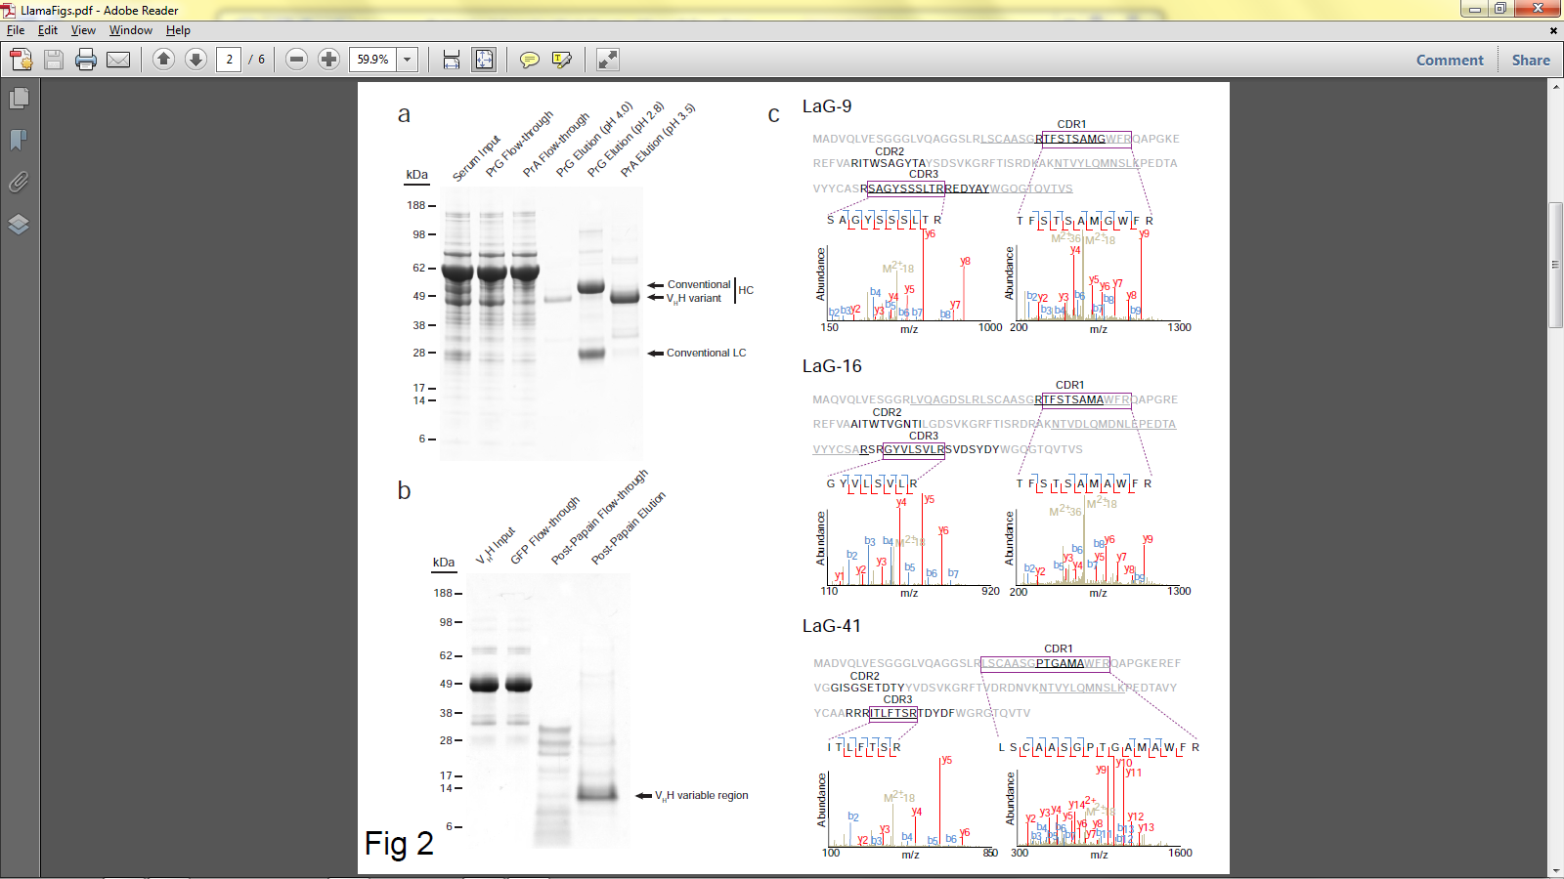
Identifying full-length sequences from peptides

Slide 20
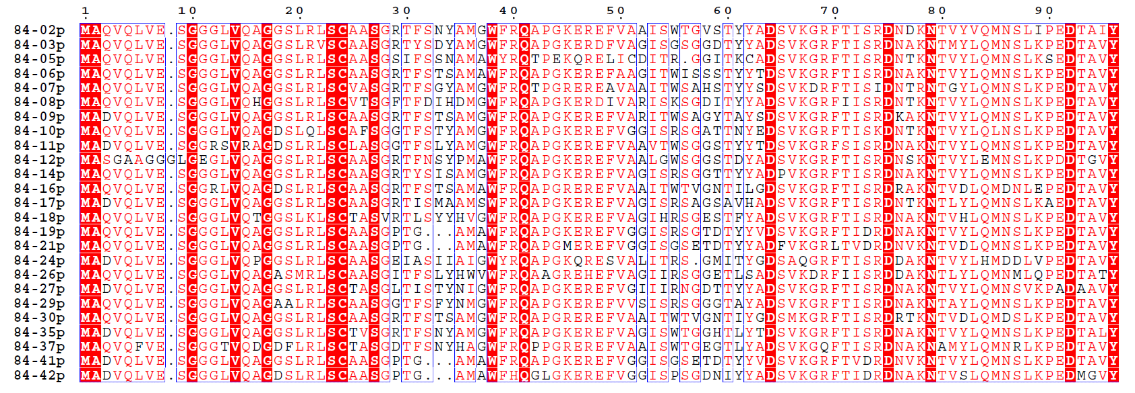
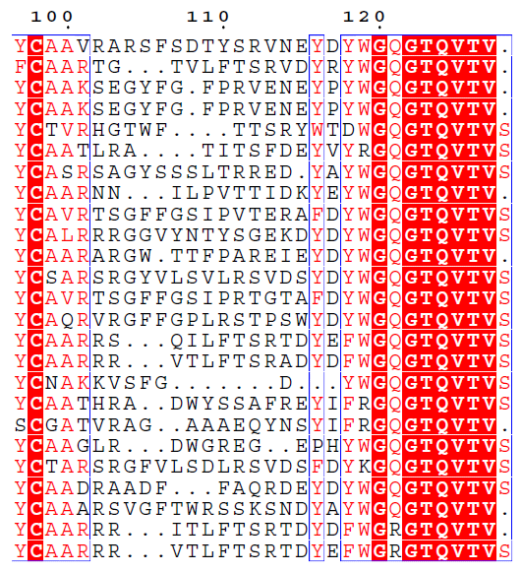
Sequence diversity of 26 verified
anti-GFP nanobodies
Of ~200 positive sequence hits, 44 high confidence clones were synthesized and tested for expression and GFP binding: 26 were confirmed GFP binders.
Sequences have characteristic conserved VHH residues, but significant diversity in CDR regions.
FR1
CDR1
FR2
CDR2
FR3
CDR3
FR4

Slide 21
HIV-1
gp120
Lipid Bilayer
gp41
RT
MA
IN
PR
Genome
NC
MA
CA
NC
p6
gp120
gp41
CA
vpu
nef
RNA
gag
vif
env
5’ LTR
pol
tat
3’ LTR
Particle
vpr
rev
PR
RT
IN
9,200 nucleotides

Slide 22
Random Insertion of 5 Amino Acids in
Proviral DNA Clone
Kan^{r}
+
Kan^{r}
PmeI Site
R7/3
Digestion &
Ligation
Random insertion of 5 amino acids (PmeI)
within specific viral coding region

Slide 23
Fitness Landscape of Targeted Viral Segment
Day 1
Day 3
Day 6

Slide 24
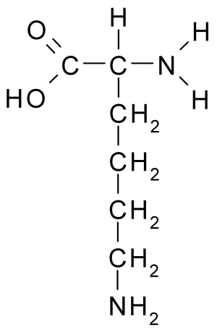
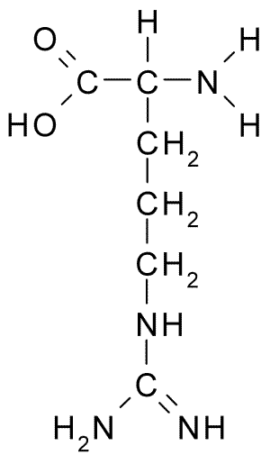
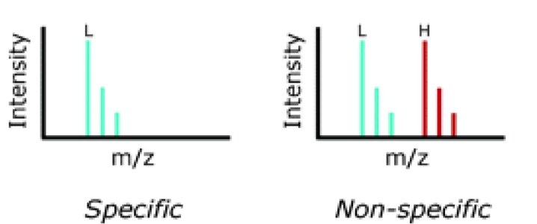
Specific and Non-Specific Interactors
I-DIRT = Isotopic Differentiation of Interactions as Random or Targeted
3xFLAG Tagged HIV-1
WT HIV-1
Infection
Light
Heavy
(¹³C labeled Lys, Arg)
1:1 Mix
Immunoisolation
MS
Lys
Arg
Modified from Tackett AJ et al., J Proteome Res. (2005) 4, 1752-6.
(+6 daltons)
(+6 daltons)

Slide 25
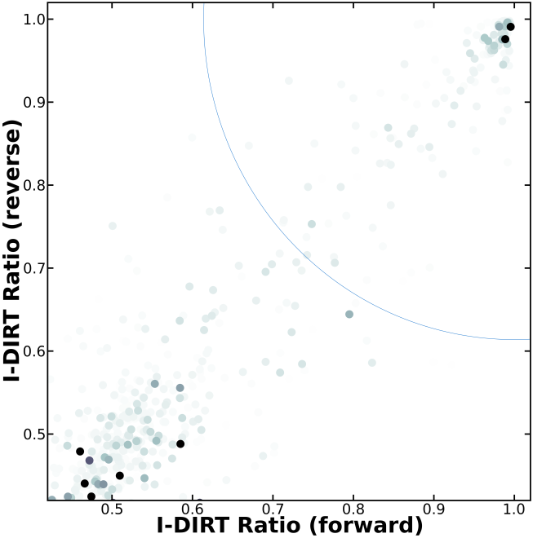
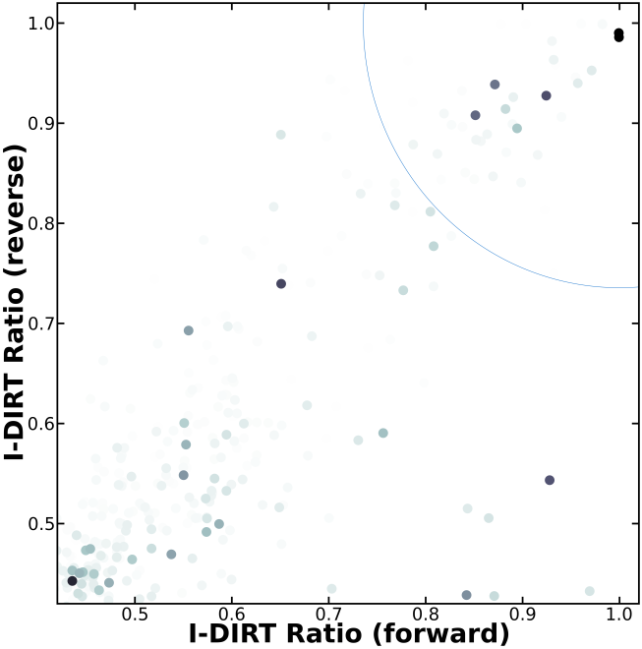
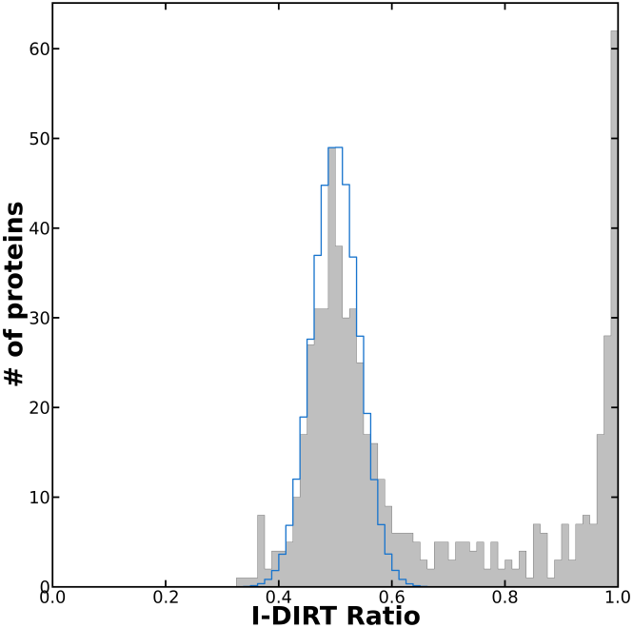
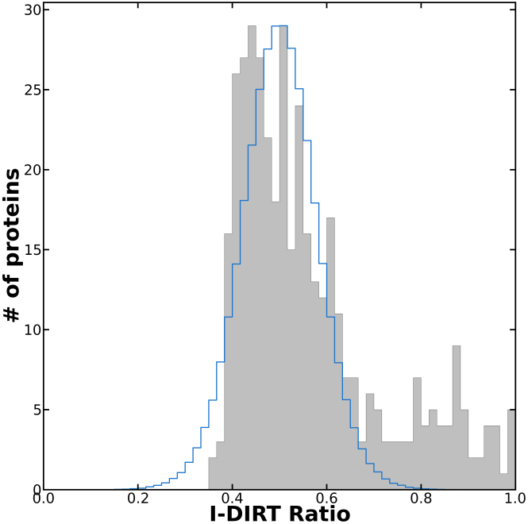
Specific and Non-Specific Interactors
Env-3xFLAG
Vif-3xFLAG

Slide 26
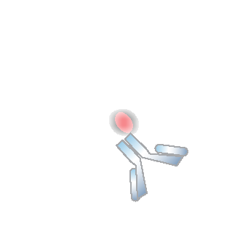
Limitation of Light Microscopy
300 nm
3 nm

Slide 27

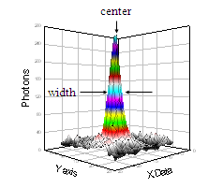
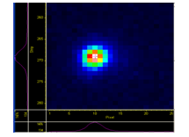
Fluorescent Imaging with
One Nanometer Accuracy (FIONA)
CCD image of a single Cy3 molecule:
Width ~ 250nm
Center is localized within width/(S/N)
(S/N)² ~ N
N = total # photon
(for N ~ 10⁴ center within ~ 1.3 nm)
Y axis
X axis
Yildiz et al, Science 2003.
Paul Selvin

Slide 28
Limitation of Light Microscopy
3 nm
3 nm
3 nm
3 nm
3 nm
3 nm
3 nm
3 nm
3 nm

Slide 29
Limitation of Light Microscopy
3 nm
3 nm
3 nm
3 nm
3 nm
3 nm
3 nm
3 nm
3 nm

Slide 30
Limitation of Light Microscopy
3 nm
3 nm
3 nm
3 nm
3 nm
3 nm
3 nm
3 nm
3 nm

Slide 31
Limitation of Light Microscopy
3 nm
3 nm
3 nm
3 nm
3 nm
3 nm
3 nm
3 nm
3 nm

Slide 32
Limitation of Light Microscopy
20 nm
20 nm
20 nm
20 nm
20 nm
20 nm
20 nm
20 nm
20 nm

Slide 33
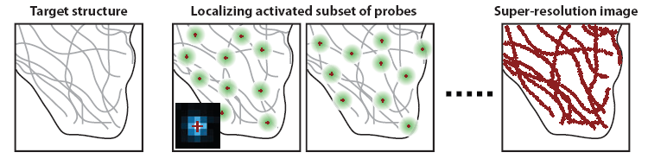
Super-Resolution Localization Microscopy
PALM: PhotoActivation Localization Microscopy
Using fluorescence proteins (mEOS, etc)
Using two lasers for interchangeable activation and excitation of probes
Betzig, 2006 Science
STORM: STochastic Optical Reconstruction Microscopy
Using doubly labeled (Cy3-Cy5) Ab
Bates, 2007 Science
Huang, Annu. Rev. Biochem, 2009

Slide 34
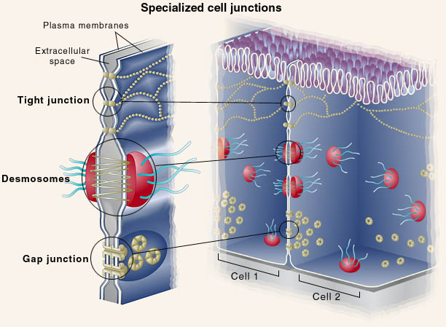
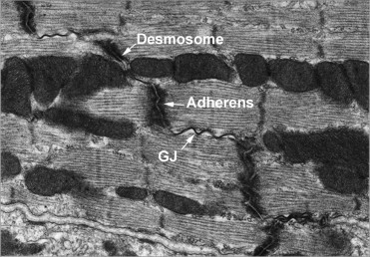
Molecular Organization
of the Intercalated Disc
Saffitz, Heart Rhythm (2009)
Notes:
CIRCLE/Q marks

Slide 35
Molecular Organization
of the Intercalated Disc
Plakophilin-2 (PKP2) Desmosome
Connexin43 (Cx43)
Gap junctions
What is the interaction map of ID proteins?
Agullo-Pascual E, Reid DA, Keegan S, Sidhu M, Fenyö D, Rothenberg E, Delmar M. "Super-resolution fluorescence microscopy of the cardiac connexome reveals plakophilin-2 inside the connexin43 plaque“, Cardiovasc Res. 2013
Notes:
CIRCLE/Q marks

Slide 36
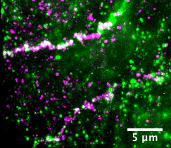
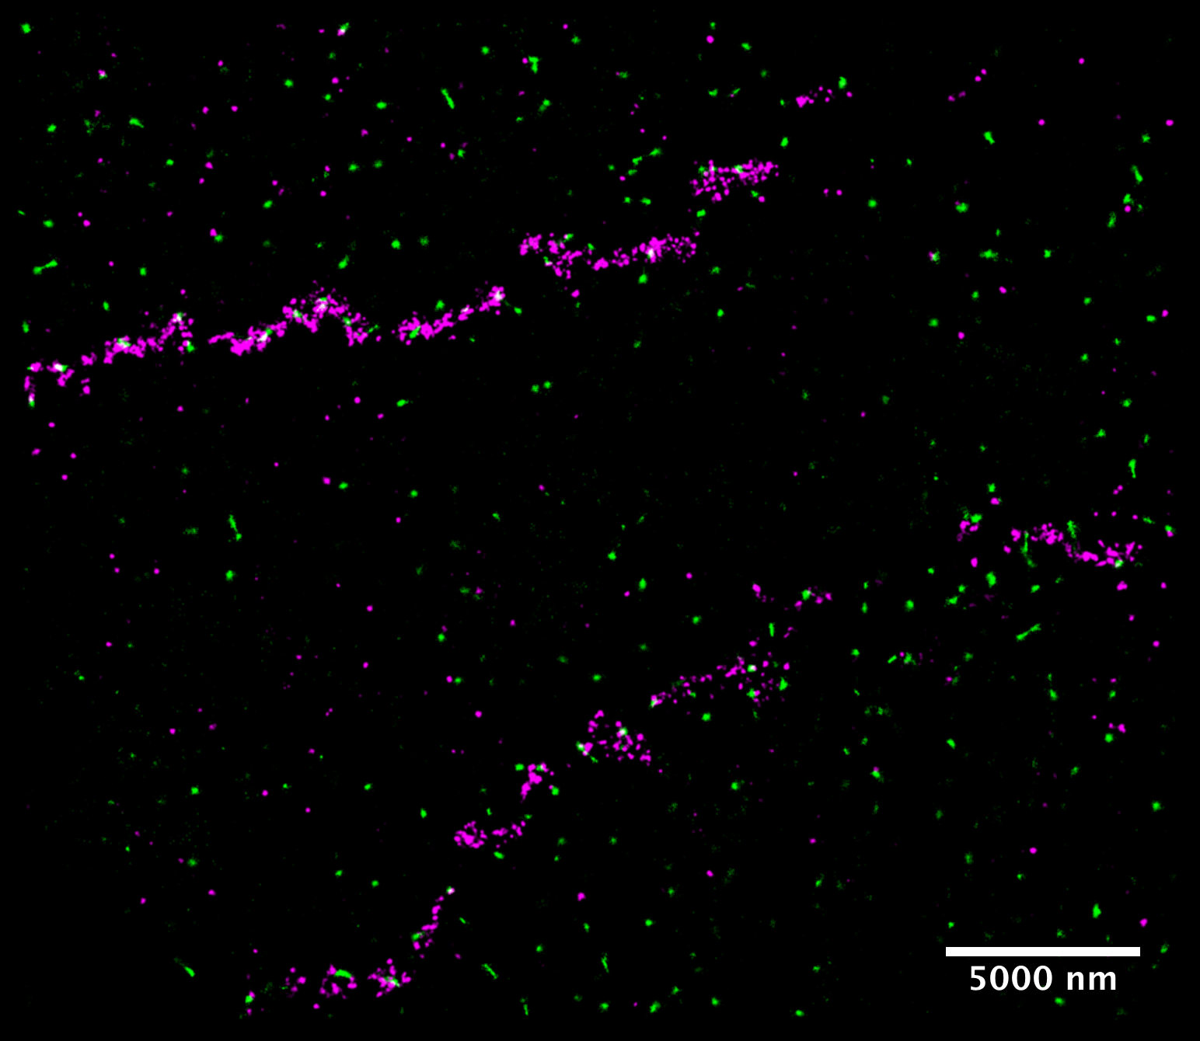
Regular Microscopy v.
Super-Resolution
Cx43
PKP2

Slide 37
Regular Microscopy v.
Super-Resolution
Cx43
PKP2

Slide 38
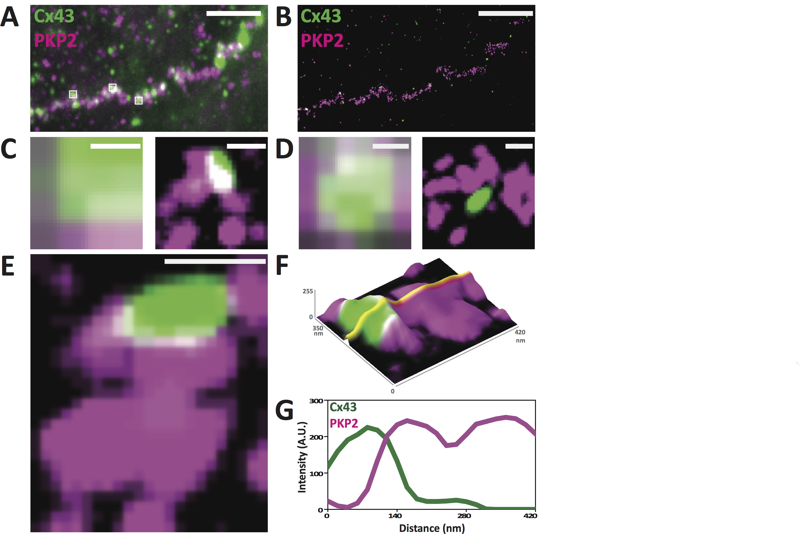
Regular Microscopy v.
Super-Resolution
Cx43
PKP2

Slide 39
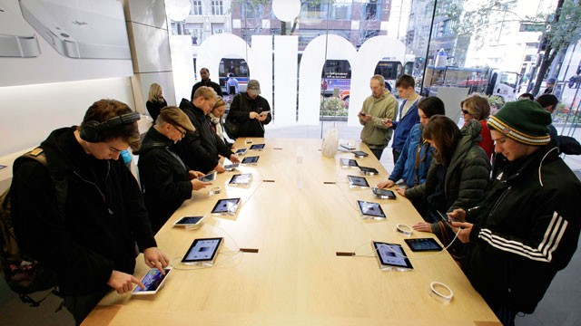

What Do We Mean by Colocalization?

Slide 40
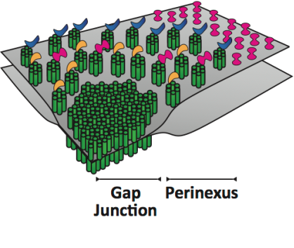
Characterization of Cx43 Clusters
Scale =200 nm
Two distinct size populations corresponding to hemi-channels and full channels.
Predominantly circular

Slide 41
Cx43-PKP2 Overlap Analysis
100% overlap
50% overlap
Cx43
A correlation between overlap and Cx43 cluster area

Slide 42
Effect AnkG Silencing on Cx43
100% overlap
50% overlap
AnkG Sil
AnkG silencing results in increase of Cx43 cluster size and loss of circularity.

Slide 43
Monte-Carlo Simulations

Slide 44
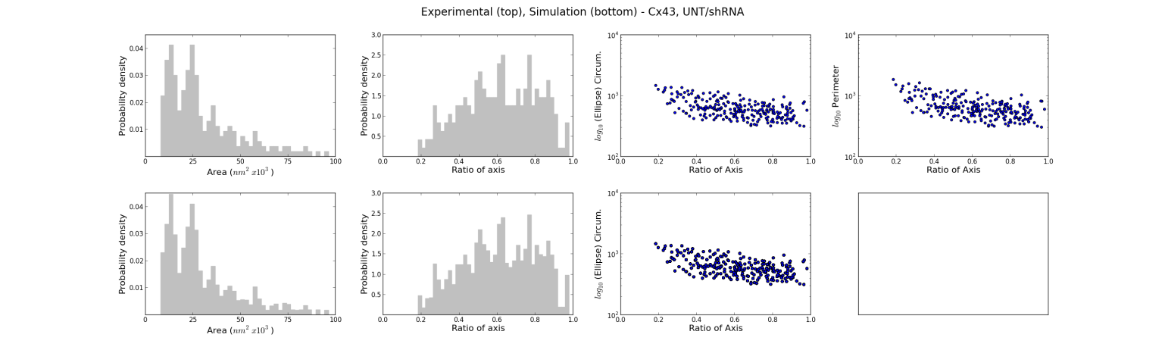
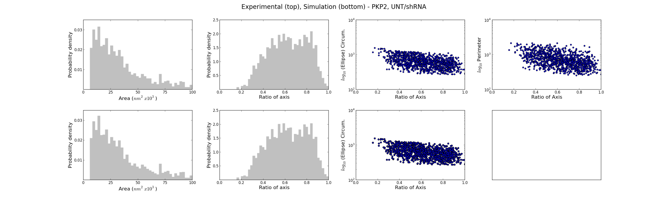
Monte-Carlo Simulations
Experiment
Simulation
Cx43
Experiment
Simulation
PKP2

Slide 45
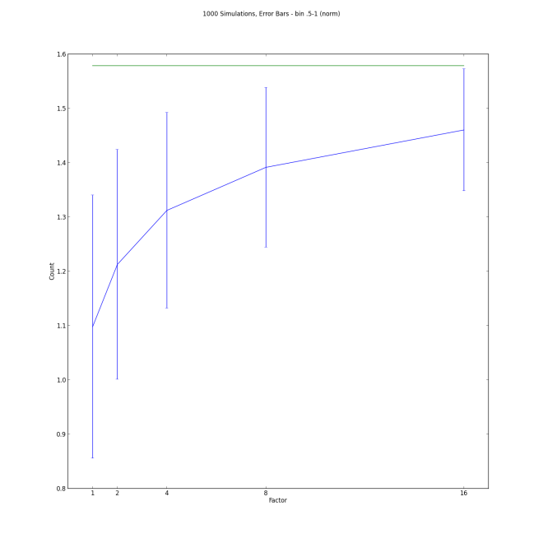



Is the Observed Overlap Random?
Untreated
AnkG Silencing
Experiment
Experiment
Colocalization
Area
Cx43 Area
Uniform
Untreated
AnkG Silencing
Non-uniform
Colocalization
Area
Experiment
Cx43 Area
Experiment

Slide 46
Proteomics Informatics –
Protein Characterization II:
Protein Interactions (Week 11)

